Slide 1
Employee Data Analysis using Excel
STUDENT NAME: Rithika.S
REGISTER NO: 312214939
DEPARTMENT: B.Com (General)
COLLEGE: Annai veilankanni's college for women

Slide 2
PROJECT TITLE
Salary and Compensation Analysis through Excel Data Modelling

Slide 3


AGENDA
Problem Statement
Project Overview
End Users
Our Solution and Proposition
Dataset Description
Modelling Approach
Results and Discussion
Conclusion
3/21/2024 Annual Review

Slide 4

PROBLEM STATEMENT
1. Identify trends and disparities in current compensation practices. 2. Evaluate internal equity and ensure fair pay for similar roles and performances. 3. Assess market competitiveness and adjust compensation to attract and retain top talent. 4. Develop a data-driven approach to inform compensation decisions and budget planning. 5. Create a scalable and sustainable compensation model that aligns with business objectives.

Slide 5

PROJECT OVERVIEW
Data Collection: - Gather salary and compensation data from various sources (HR systems, surveys, market research) - Ensure data accuracy, completeness, and consistency.
Data Modeling: - Design an Excel data model to organize and structure the data - Create tables, relationships, and formulas to facilitate analysis.
Analysis and Visualization: - Develop dashboards, reports, and charts to facilitate analysis and insights - Include metrics such as: - Average salary by role, department, and location - Compensation ratios (e.g., salary to market average) - Pay equity analysis (gender, ethnicity, etc.) - Bonus and benefits analysis - Turnover and retention rates.
4. Findings and Recommendations: - Identify trends, disparities, and areas for improvement - Provide recommendations for compensation adjustments and policy changes.

Slide 6

WHO ARE THE END USERS?
The end users of a salary and compensation analysis through Excel data modeling may include:
HR Professionals: Responsible for designing and implementing compensation strategies, they will use the analysis to inform decisions and ensure fair pay practices.
Compensation Analysts: They will utilize the data model to analyze and interpret compensation data, identifying trends and areas for improvement.
Business Leaders: CEOs, CFOs, and department heads will use the insights to make strategic decisions about talent management, budgeting, and resource allocation.
Line Managers: They will use the analysis to understand market rates, make informed hiring decisions, and manage employee expectations.
Finance Teams: They will utilize the data to budget and forecast compensation expenses, ensuring alignment with organizational financial goal.

Slide 7

OUR SOLUTION AND ITS VALUE PROPOSITION
A comprehensive Excel-based data model that integrates and analyzes salary and compensation data from various sources.
Automated data visualization dashboards and reports providing insights on.
Market competitiveness.
Pay equity and fairness.
Compensation trends and disparities.
Budgeting and forecasting.
Identification of areas for improvement and recommendations for compensation adjustments and policy change.
*Data-Driven Decision Making:* Enable informed decisions on compensation strategies, talent management, and budgeting with accurate and up-to-date data analysis.

Slide 8
Dataset Description
1. The dataset for the Salary and Compensation Analysis includes comprehensive employee information such as job titles, departments, base salaries, bonuses, benefits, and tenure.
2. It may also incorporate performance metrics, demographic data, and market salary
benchmarks.
3. This diverse dataset enables a thorough examination of pay equity, compensation trends, and discrepancies across different employee groups.
4. Structured in Excel, the data is clean, well-organized, and ready for advanced analysis, allowing for the creation of meaningful insights and actionable recommendations.

Slide 9

THE "WOW" IN OUR SOLUTION
1. The “wow” factor in our solution lies in its dynamic and interactive Excel data models that seamlessly integrate multiple data sources to provide real-time insights into salary and compensation trends.
2. Through advanced visualizations and customizable
dashboards, users can effortlessly explore complex data sets, uncover hidden patterns, and generate actionable recommendations.
3. This intuitive approach not only simplifies data analysis but also empowers decision-makers with a clear, strategic view of compensation practices, enhancing both transparency and strategic alignment.
3/21/2024 Annual Review
9

Slide 10
MODELLING
1. In our Salary and Compensation Analysis, Excel data modeling involves
aggregating and cleaning employee salary and benefit data, followed by
using pivot tables to summarize key metrics such as average salaries and
pay distributions.
2. We employ advanced formulas and visualizations to benchmark salaries
against industry standards and identify disparities. Interactive dashboards
enable real-time scenario analysis, allowing stakeholders to assess
various compensation strategies and their impact.
3. This comprehensive approach provides actionable insights for optimizing
compensation and ensuring fairness.
10

Slide 11
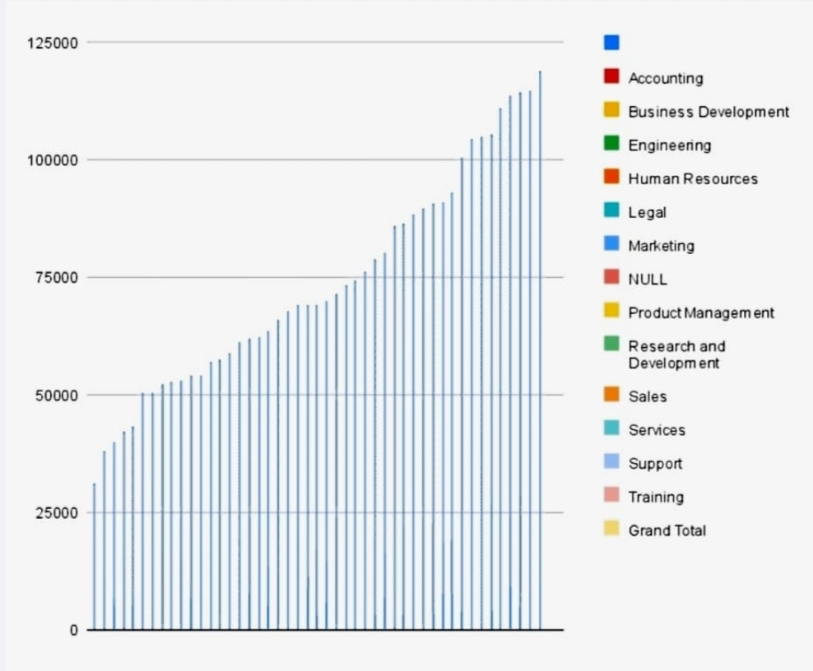
RESULTS
‹#›

Slide 12
conclusion
1. In Conclusion of Salary and Compensation Analysis through Excel data
modeling offers a powerful solution for organizations to optimize their
compensation strategies.
2. By leveraging Excel's data modeling capabilities, organizations can:- Gain
actionable insights into pay equity, market positioning, and compensation
trends.
3. Develop data-driven recommendations for salary adjustments, bonus and merit increase optimization, and compensation package design.
4. Enhance diversity, equity, and inclusion initiatives- Improve budgeting and forecasting accuracy- Drive business outcomes, including competitive
advantage, cost savings, and regulatory compliance.

